Slide 1
UNIT- II
Maximum likelihood estimation- Least squares, Robust linear expression, ridge regression, Bayesian linear regression, Linear models for classification: Discriminant function, Probabilistic generative models, Probabilistic discriminative models, Laplacian approximation, Bayesian logistic regression, Kernel functions, using kernels in GLM, Kernel trick, SVMs.

Slide 2
Maximum Likelihood Estimation

Slide 3
Maximum Likelihood Estimation
Maximum Likelihood Estimation (MLE) is a statistical method used to estimate the parameters of a probability distribution that best describe a given dataset.
To analyze the data provided, we need to identify the distribution from which we have obtained data.
Next, use data to find the parameters of our distribution. A parameter is a numerical characteristic of a distribution.
Example Distribution and their parameters:
Normal distributions - mean (µ) & variance (σ2)
Binomial distributions –no.of trials (n) & probability of success (p)
Gamma distributions - shape (k) and scale (θ)
Exponential distributions - inverse mean (λ).
These parameters are vital for understanding the size, shape, spread, and other properties of a distribution.
Since the data that we have is mostly randomly generated, we often don’t know the true values of the parameters characterizing our distribution.

Slide 4
Maximum Likelihood Estimation
An estimator is like a function of data that gives approximate values of the parameters.
Ex: sample-mean estimator – Simple & Frequently used estimator
Since the numerical characteristics of the distribution vary as a function of the range of parameter it is not easy to estimate parameter θ of the distribution.
Maximum likelihood estimation, which is a process of estimation that gives an entire class of estimators called maximum likelihood estimators or MLEs

Slide 5
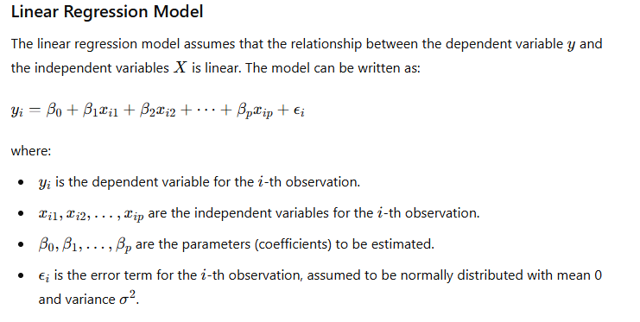
MLE – for Linear Regression Model
In the context of linear regression, MLE is used to estimate the coefficients (parameters) of the regression model.

Slide 6
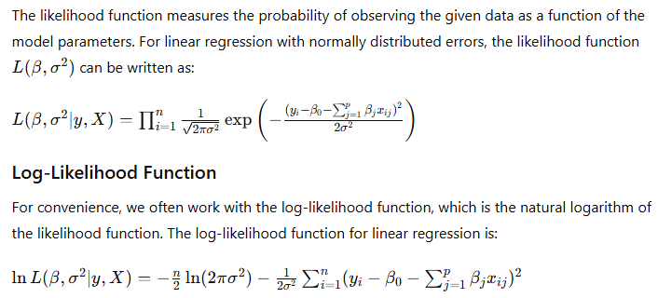
Likelihood Function

Slide 7
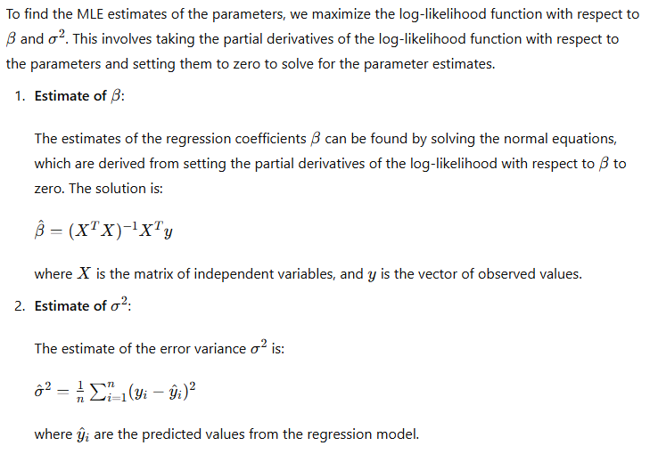
Maximizing Log-Likelihood

Slide 8
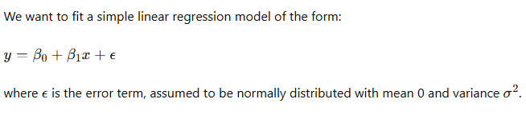
Example - Maximum likelihood estimation
Let's work through an example of using Maximum Likelihood Estimation (MLE) in linear regression.
Example : We have a dataset with the following observations:
X | Y
1 | 2
2 | 3
3 | 5
4 | 4
2 | 6

Slide 9
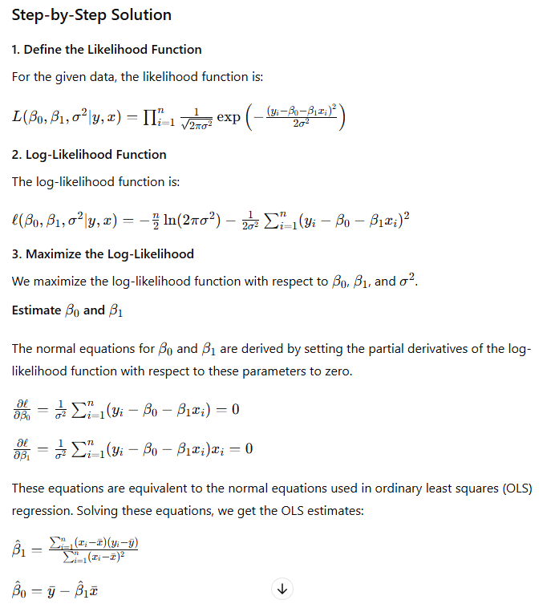

Slide 11
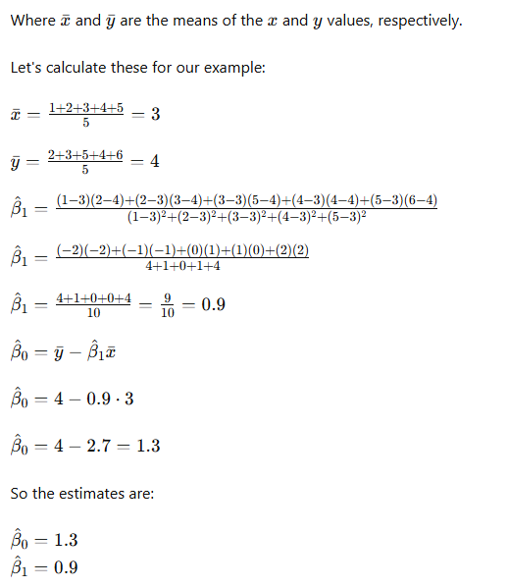
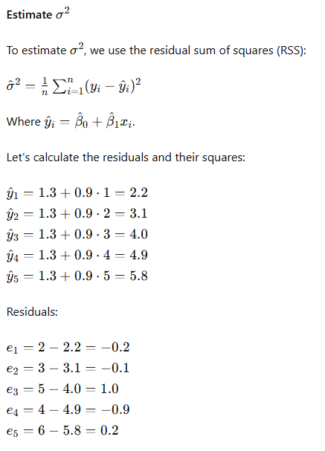

Slide 12
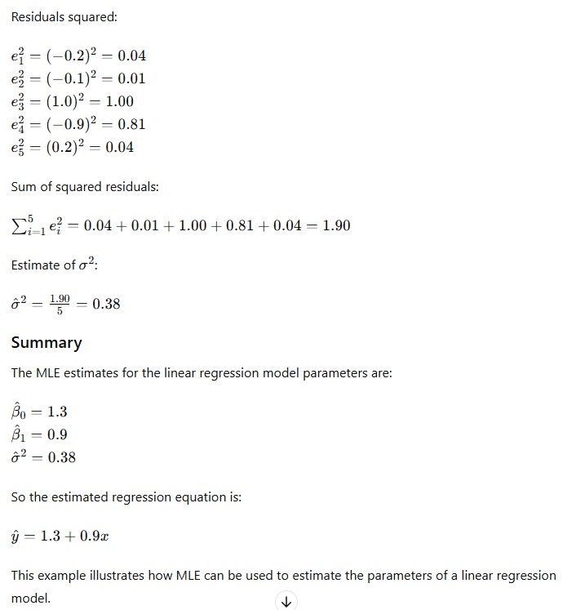

Slide 14
Robust linear expression

Slide 15

Robust linear expression
Robust linear regression is designed to be less sensitive to outliers compared to traditional linear regression.
Traditional linear regression minimizes the sum of squared residuals, which can be heavily influenced by outliers.
Robust linear regression uses different techniques to mitigate the effect of outliers and produce a more reliable model.

Slide 16
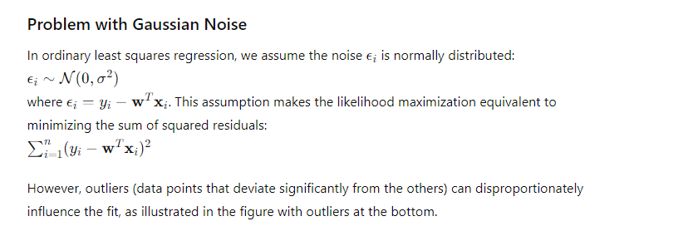
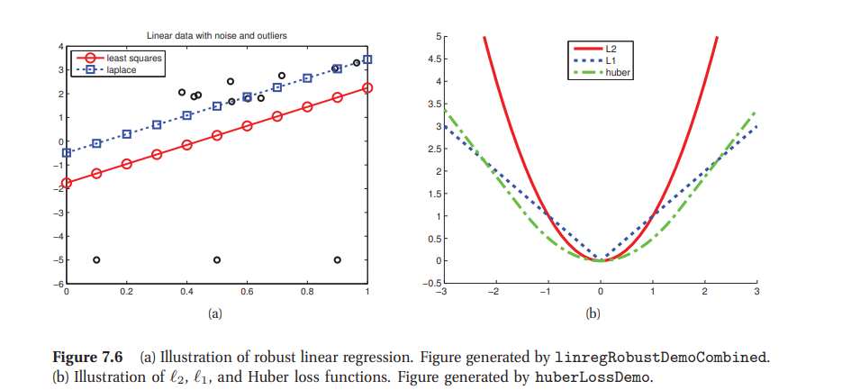

Slide 17
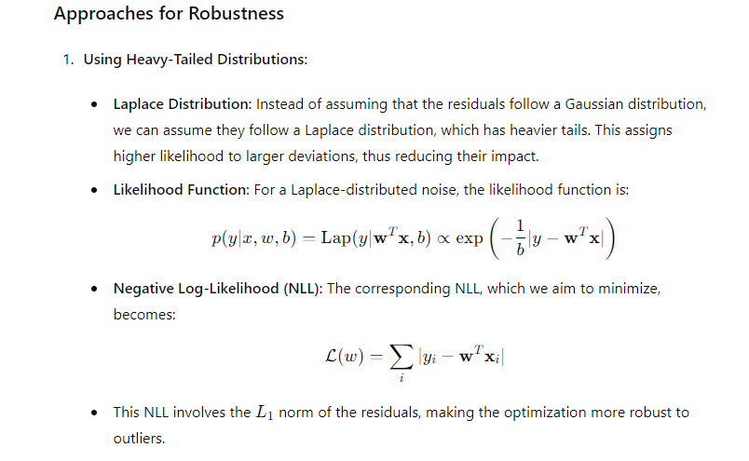

Slide 18
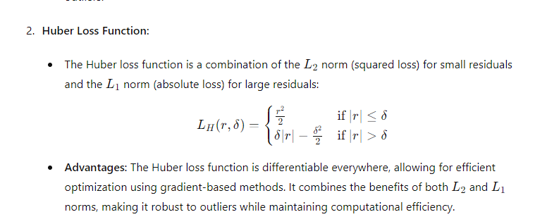

Slide 19
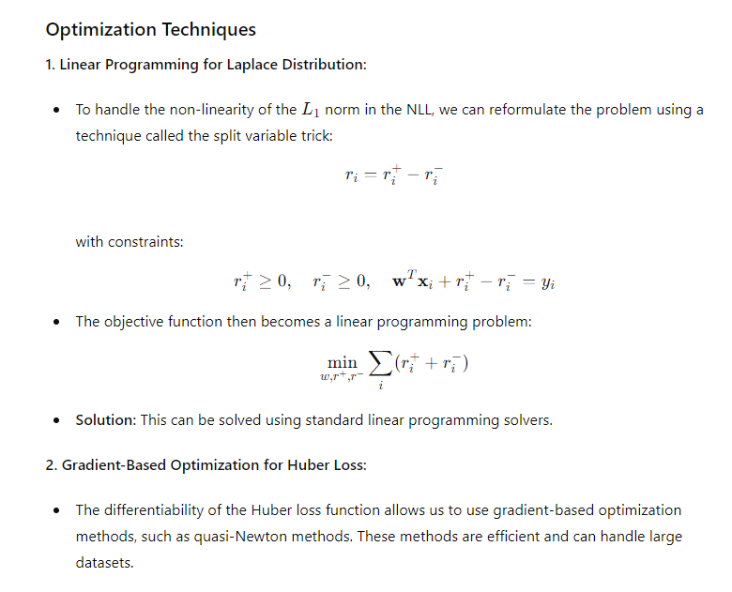

Slide 20
Robust linear expression

Slide 21
Ridge regression
Problem with MLE: Maximum Likelihood Estimation (MLE) can lead to overfitting because it finds the parameter values that best fit the training data, which may result in overly complex models, especially when the data is noisy.
Gaussian Prior: To mitigate overfitting, ridge regression uses Maximum A Posteriori (MAP) estimation with a Gaussian prior on the parameters. The Gaussian prior assumes that the parameters should be small, which helps to create smoother, less complex models.

Slide 22
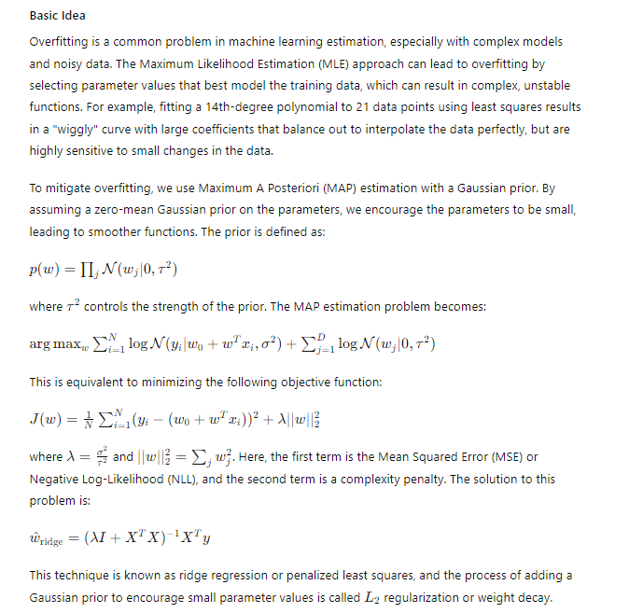

Slide 23
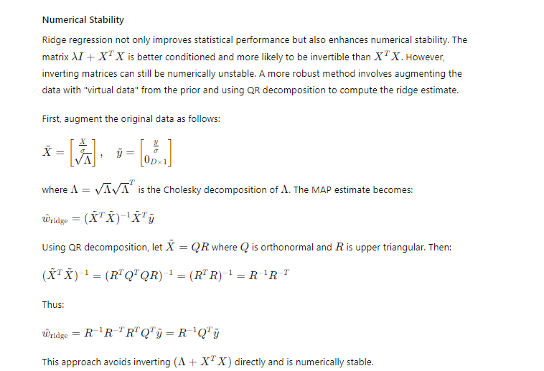

Slide 24
Bayesian linear regression

Slide 25
Bayesian linear regression
Bayesian linear regression extends the traditional linear regression framework by incorporating prior beliefs about the parameters, resulting in a full posterior distribution for the parameters. This approach offers several advantages, including better handling of uncertainty and robustness to overfitting.

Slide 26
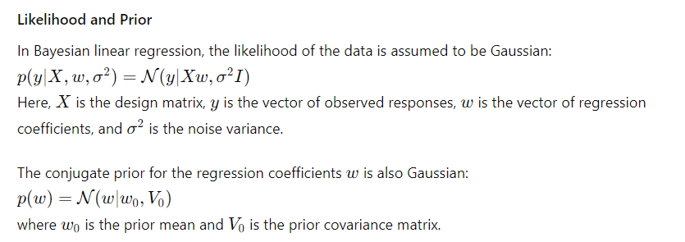

Slide 27
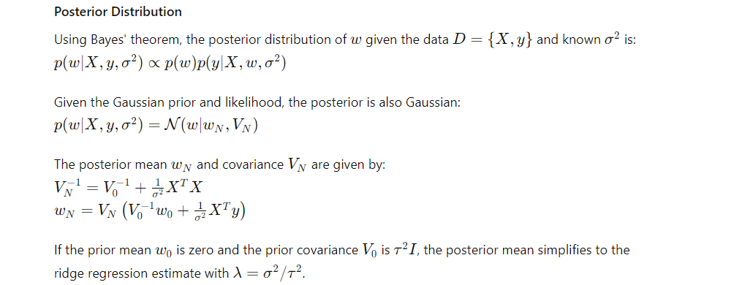

Slide 28
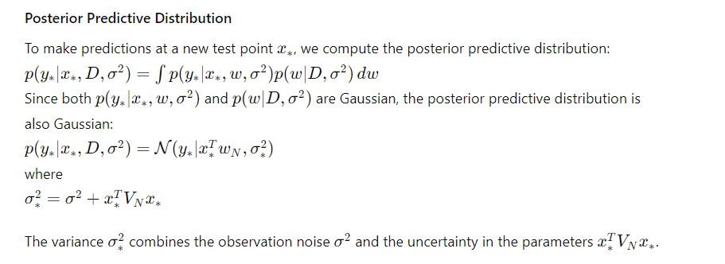

Slide 29
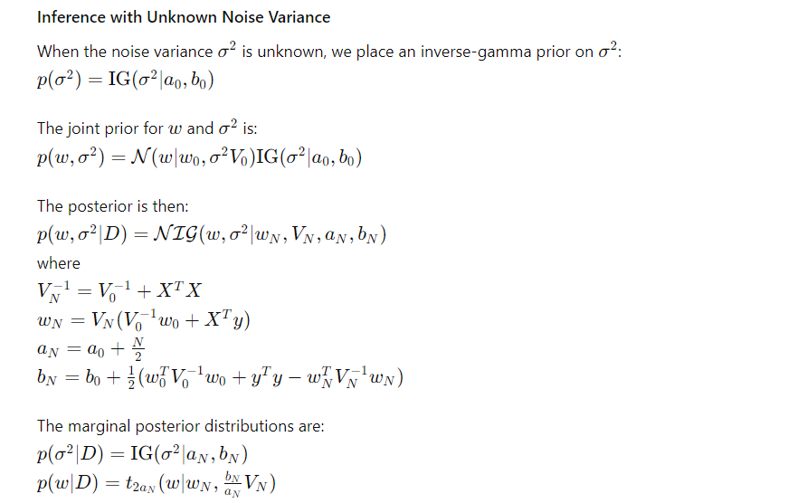

Slide 30
Robust linear regression is used when the data contains outliers or non-normal errors that can unduly influence the results of ordinary least squares (OLS) regression.
Robust regression techniques are designed to be less sensitive to outliers and provide more reliable parameter estimates.One common method for robust regression is the Huber loss, which combines the squared loss (used in OLS) and the absolute loss.
This approach reduces the influence of outliers by treating small residuals with the squared loss and large residuals with the absolute loss.

Slide 31
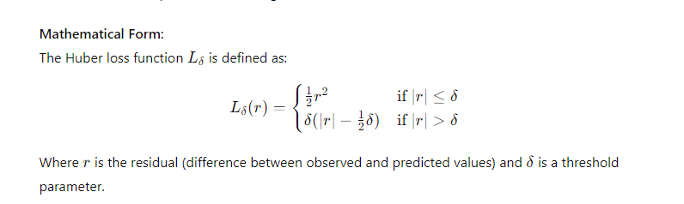

Slide 32
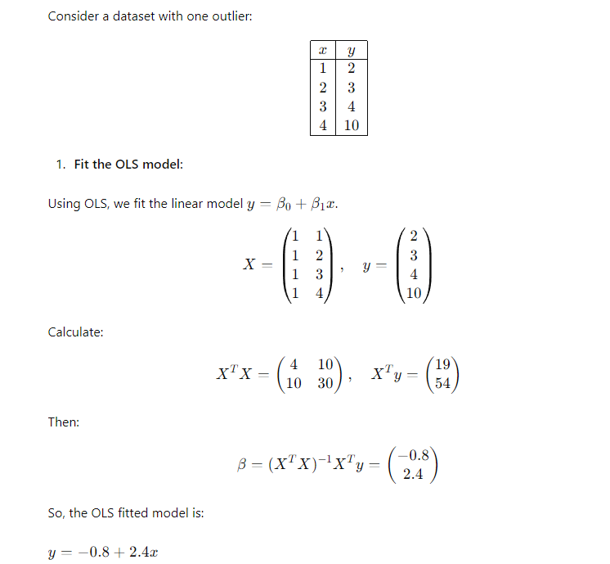

Slide 33
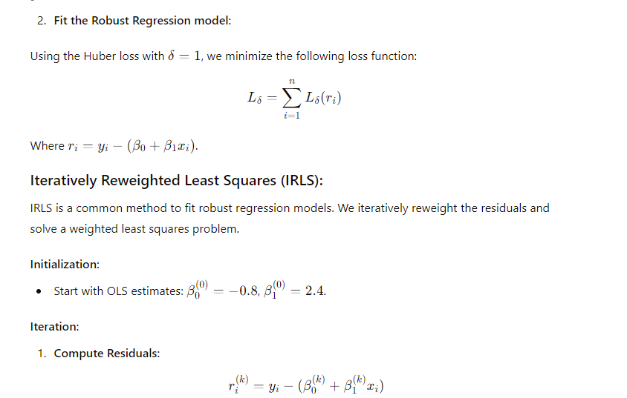

Slide 34
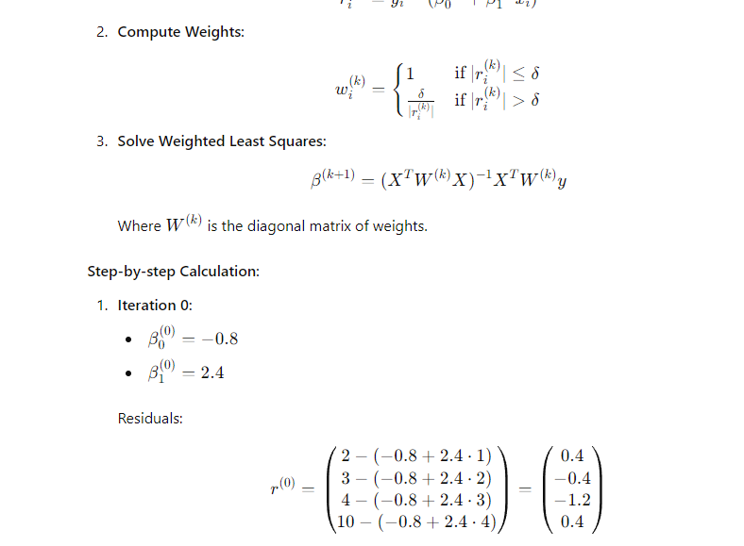

Slide 35
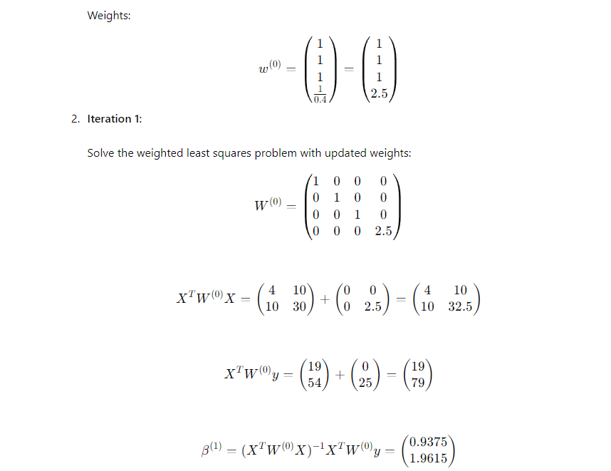

Slide 36
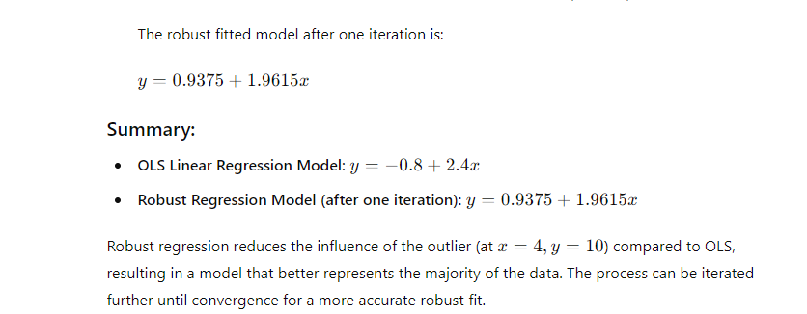

Slide 37
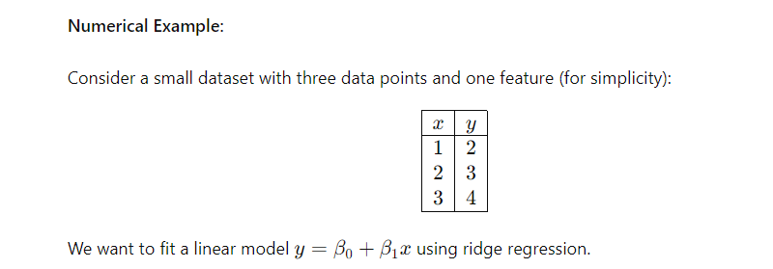

Slide 38
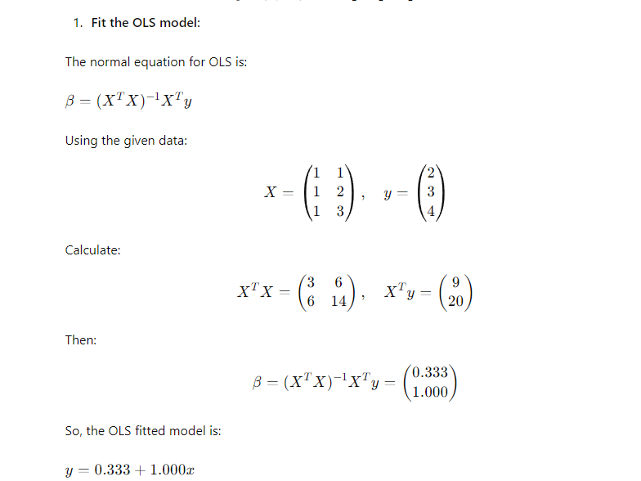

Slide 39
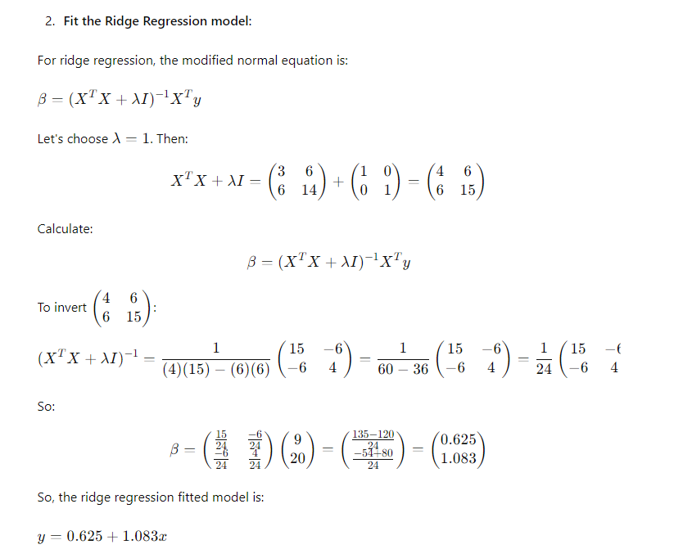

Slide 40
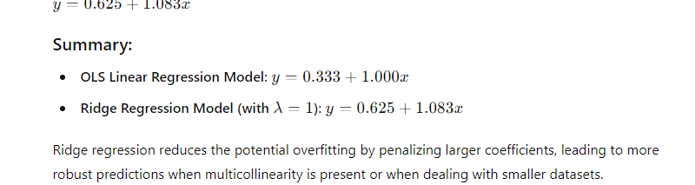

Slide 41
Discriminant Functions

Slide 42
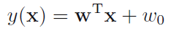
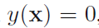
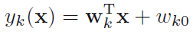
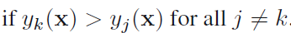
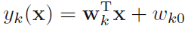
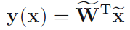
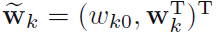
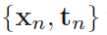
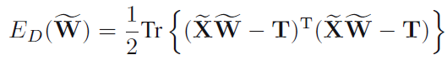
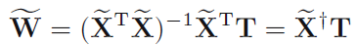
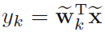
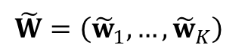
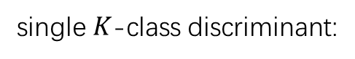
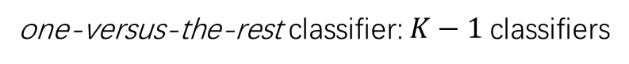
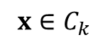
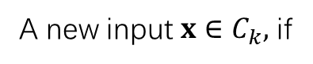
Discriminant Functions
Two classes
Decision boundary:
Multiple classes
one-versus-the-rest classifier: $K−1$classifiers
one-versus-one classifier: $K(K − 1)/2$binary discriminant functions
single $K$-class discriminant:
$$x∈C_{k}$$
Least squares for classification
Each class
$$\tilde{W}=\left({\tilde{w}}_{1},…,{\tilde{w}}_{K}\right)$$
Training data
Sum-of-squares error function
A new input $x∈C_{k},$ if
is largest.
Notes:
A discriminant is a function that takes an input vector x and assigns it to one class.

Slide 43
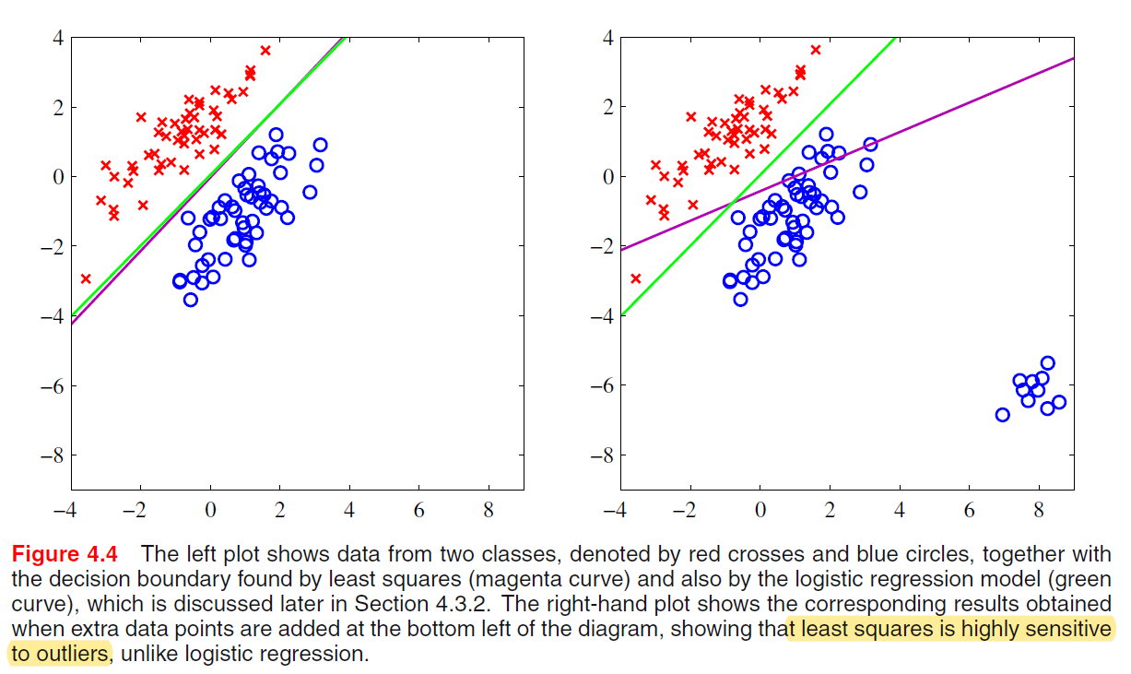
Discriminant Functions
Least squares for classification

Slide 44
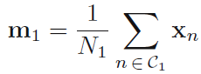
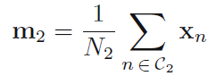
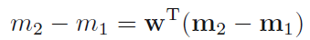
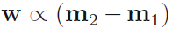







Discriminant Functions
Fisher’s linear discriminant
select a projection that maximizes the class separation
maximize
have considerable overlap
Fisher’s idea maximizes a function that will give a large separation between the projected class meanwhile
also giving a small variance within each class, thereby minimizing the class overlap.
class $C_{k}$’s within-class variance
The Fisher criterion
Fisher’s linear discriminant
between-class covariance matrix:
total within-class covariance matrix

Slide 45

Discriminant Functions
Fisher’s linear discriminant

Slide 46





Discriminant Functions
The perceptron algorithm
Perceptron function
nonlinear activation function
Target values
perceptron criterion
denotes the set of all misclassified patterns
Stochastic gradient descent
Perceptron convergence theorem: if there exists an exact solution (in other words, if the training data set is linearly separable), then the perceptron learning algorithm is guaranteed to find an exact solution in a finite number of steps.
Notes:
Another example of a linear discriminant model

Slide 47


Discriminant Functions
The perceptron algorithm
Illustration of the convergence of the perceptron learning algorithm, showing data points from two classes (red and blue) in a two-dimensional feature space (φ1, φ2).
The top left plot shows the initial parameter vector $w$ shown as a black arrow together with the corresponding decision boundary (black line), in which the arrow points towards the decision region which classified as belonging to the red class.
The data point circled in green is misclassified and so its feature vector is added to the current weight vector, giving the new decision boundary shown in the top right plot.
The bottom left plot shows the next misclassified point to be considered, indicated by the green circle, and its feature vector is again added to the weight vector giving the decision boundary shown in the bottom right plot for which all data points are correctly classified.

Slide 48
Probabilistic Generative Models

Slide 49


Slide 50


Slide 51


Slide 52


Slide 53


Slide 54


Slide 55


Slide 56


Slide 57


Slide 58



Slide 59
Probabilistic Discriminative Models

Slide 60







Slide 61


Slide 62


Slide 63



Slide 64


Slide 65
Laplace Approximation

Slide 66



Laplace Approximation
The Laplace Approximation aims to find a Gaussian approximation to a probability density defined over a set of continuous variables.
Consider first the case of a single continuous variable z, and suppose the distribution p(z) is defined by

Slide 67





Laplace Approximation…

Slide 68

Laplace Approximation…
Gaussian approximation will only be well defined if its precision A > 0, in other words the stationary point z0 must be a local maximum, so that the second derivative of f(z) at the point z0 is negative.

Slide 69




Laplace Approximation…
and ∇ is the gradient operator. Taking the exponential of both sides we obtain
The distribution q(z) is proportional to f(z) and the appropriate normalization coefficient can be found by inspection, using the standard result for a normalized multivariate Gaussian, giving

Slide 70
Laplace Approximation…
One major weakness of the Laplace approximation is that, since it is based on a Gaussian distribution, it is only directly applicable to real variables.
In other cases it may be possible to apply the Laplace approximation to a transformation of the variable. For instance if 0 <T < ∞ then we can consider a Laplace approximation of ln τ .
The most serious limitation of the Laplace framework, however, is that it is based purely on the aspects of the true distribution at a specific value of the variable, and so can fail to capture important global properties.

Slide 71
Bayesian Logistic Regression

Slide 72

Bayesian Logistic Regression
Exact Bayesian inference for logistic regression is intractable.
In particular, evaluation of the posterior distribution would require normalization of the product of a prior distribution and a likelihood function that itself comprises a product of logistic sigmoid functions, one for every data point.
Evaluation of the predictive distribution is similarly intractable.
it is natural to begin with a Gaussian prior, which we write in the general form

Slide 73

Bayesian Logistic Regression…

Slide 74

Bayesian Logistic Regression…

Slide 75

Predictive distribution

Slide 76



Predictive distribution…

Slide 77


Predictive distribution…

Slide 78
Kernel functions, using kernels in GLM, Kernel trick

Slide 79

Kernel Trick
SVM algorithms use a set of mathematical functions that are defined as the kernel. The function of kernel is to take data as input and transform it into the required form.
Firstly, a kernel takes the data from its original space and implicitly maps it to a higher-dimensional space. This is crucial when dealing with data that is not linearly separable in its original form.
Instead of performing computationally expensive high-dimensional calculations, the kernel function calculates the relationships or similarities between pairs of data points as if they were in this higher-dimensional space.

Slide 80




Kernel Trick
Kernel Trick allows us to operate in the original feature space without computing the coordinates of the data in a higher dimensional space.
Example:
Here x and y are two data points in 3 dimensions. Let’s assume that we need to map x and y to 9-dimensional space. We need to do the following calculations to get the final result, which is just a scalar.
The computational complexity, in this case, is O(n²).
However, if we use the kernel function, which is denoted as k(x, y), instead of doing the complicated computations in the 9-dimensional space, we reach the same result within the 3-dimensional space by calculating the dot product of x -transpose and y.
The computational complexity, in this case, is O(n).
Kernel trick does for us is to offer a more efficient and less expensive way to transform data into higher dimensions.

Slide 81


Kernel Trick
Numerical Example for working of Kernel Function
Feature(x) | -6 | -5 | -4 | -3 | -2 | -1 | 0 | 1 | 2 | 3 | 4 | 5 | 6
X² | 36 | 25 | 16 | 9 | 4 | 2 | 0 | 1 | 4 | 9 | 16 | 25 | 36
Fig 1: Linearly inseparable data in one dimension
Fig 2: Applying kernel method to represent data in two dimensions

Slide 82

Kernel Functions
Let κ(x, x’) ≥ 0 be some measure of similarity between objects x, x’ ∈ X , where X is some abstract space; we will call κ a kernel function.
We define a kernel function to be a real-valued function of two arguments, κ(x, x’ ) ∈ R, for x, x’ ∈ X . Typically the function is symmetric (i.e., κ(x, x’ ) = κ(x’ , x)), and non-negative (i.e., κ(x, x’ ) ≥ 0.
Linear Kernel:
Let φ(x) = x, we get the linear kernel, defined by just the dot product between the two object vectors:
This is useful if the original data is already high dimensional, and if the original features are individually informative,
e.g., a bag of words representation where the vocabulary size is large, or the expression level of many genes.
In such a case, the decision boundary is likely to be representable as a linear combination of the original features, so it is not necessary to work in some other feature space

Slide 83







Kernel Functions
Mercer Kernel:
Let X = {x1, . . . , xn} be a finite set of n samples from ჯ. The Gram matrix of X is defined as
If ∀X ⊆ ჯ , the matrix K is positive definite, κ is called a Mercer Kernel, or a positive definite kernel.
Mercer’s Theorem: If the Gram matrix is positive definite, we can compute an eigenvector decomposition of it as
where Λ is a diagonal matrix of eigenvalues λi > 0. Now consider an element of K:
Let us define Then we can write
Thus entries in the kernel matrix can be computed by performing an inner product of some feature vectors that are implicitly defined by the eigenvectors U. In general, if the kernel is Mercer, then there exists a function φ mapping x ∈ ჯ to such that

Slide 84


Kernel Functions
Polynomial Kernel:
It represents the similarity of vectors in the training set of data in a feature space over polynomials of the original variables used in the kernel.
Where r>0.
Sigmoid Kernel:
An example of a kernel that is not a Mercer kernel is the so-called sigmoid kernel, defined by
this function is equivalent to a two-layer, perceptron model of the neural network, which is used as an activation function for artificial neurons.

Slide 85

Kernel Functions
RBF Kernel:
The below function is the Gaussian or RBF kernel
Here σ is the variance and our hyperparameter
||x-x’|| is the Euclidean (L₂-norm) Distance between two points x and x’
When using a Gaussian kernel in an SVM, the decision boundary is a nonlinear hyper plane that can capture complex nonlinear relationships between the input features.
The width of the Gaussian function, controlled by the gamma parameter, determines the degree of nonlinearity in the decision boundary.

Slide 86



Kernel Functions
RBF Kernel Illustration:
The RBF kernel function for two points X₁ and X₂ computes the similarity or how close they are to each other. This kernel can be mathematically represented as follows:
Let d₁₂ be the distance between the two points X₁ and X₂, we can now represent d₁₂ as follows:
The kernel equation can be re-written as follows:

Slide 87

Kernel Functions
RBF Kernel Illustration:
The maximum value that the RBF kernel can be is 1 and occurs when d₁₂ is 0 which is when the points are the same, i.e. X₁ = X₂.
When the points are the same, there is no distance between them and therefore they are extremely similar
When the points are separated by a large distance, then the kernel value is less than 1 and close to 0 which would mean that the points are dissimilar
Distance can be thought of as an equivalent to dissimilarity because we can notice that when distance between the points increases, they are less similar.

Slide 88


Kernel Functions
RBF Kernel Illustration:
It is important to find the right value of ‘σ’ to decide which points should be considered similar and this can be demonstrated on a case by case basis.
a] σ = 1
When σ = 1, σ² = 1 and the RBF kernel’s mathematical equation will be as follows:
The curve for this equation is given in right and we can notice that as the distance increases, the RBF Kernel decreases exponentially and is 0 for distances greater than 4.
We can notice that when d₁₂ = 0, the similarity is 1 and as d₁₂ increases beyond 4 units, the similarity is 0
From the graph, we see that if the distance is below 4, the points can be considered similar and if the distance is greater than 4 then the points are dissimilar

Slide 89


Kernel Functions
RBF Kernel Illustration:
b] σ = 0.1
When σ = 0.1, σ² = 0.01 and the RBF kernel’s mathematical equation will be as follows:
The width of the Region of Similarity is minimal for σ = 0.1 and hence, only if points are extremely close they are considered similar.
We see that the curve is extremely peaked and is 0 for distances greater than 0.2
The points are considered similar only if the distance is less than or equal to 0.2

Slide 90


Kernel Functions
RBF Kernel Illustration:
b] σ = 10
When σ = 10, σ² = 100 and the RBF kernel’s mathematical equation will be as follows:
The width of the Region of Similarity is large for σ = 100 because of which the points that are farther away can be considered to be similar.
The width of the curve is large
The points are considered similar for distances up to 10 units and beyond 10 units they are dissimilar
It is evident from the above cases that the width of the Region of Similarity changes as σ changes.
Finding the right σ for a given dataset is important

Slide 91


Kernel Functions
String Kernels:
If we’re interested in matching all substrings (for example) instead of representing an object as a bag of words, we can use a string kernel:
Let A denote an alphabet, e.g., {a, ..., z}, and A∗ = [A, A² , . . . , A^{m}], where m is the length of the longest string we would like to match. Then a basis function φ(x) will map a string x to a vector of length |A∗|, where each element j is the number of times we observe substring A∗_{j} in string x, where j = 1 : | A∗ |.
The string kernel measures the similarity of two strings x and x’ :
where φ_{s}(x) denotes the number of occurrences of substring s in string x.

Slide 92




Kernel Functions
Matern Kernel:
The Matern kernel, which is commonly used in Gaussian process has the following form
Where is a modified Bessel function.
Fisher Kernel:
We can construct a kernel based on a chosen generative model using the concept of a Fisher kernel. The idea is that this kernel represents the distance in likelihood space between different objects for a fitted generative model. A Fisher kernel is defined as
Where

Slide 93

Kernel Functions
Kernels for comparing documents:
When performing document classification or retrieval, it is useful to have a way of comparing two documents, xi and xi’ .
If we use a bag of words representation, where xij is the number of times words j occurs in document i, we can use the cosine similarity, which is defined by
This quantity measures the cosine of the angle between xi and xi’ when interpreted as vectors.
Since xi is a count vector (and hence non-negative), the cosine similarity is between 0 and 1, where 0 means the vectors are orthogonal and therefore have no words in common.
This simple method does not work very well, for two main reasons. First, if xi has any word in common with xi’ , it is deemed similar, even though some popular words, such as “the” or “and” occur in many documents, and are therefore not discriminative.
Second, if a discriminative word occurs many times in a document, the similarity is artificially boosted.

Slide 94




Kernel Functions
We can significantly improve performance using some simple preprocessing. The idea is to replace the word count vector with a new feature vector called the TF-IDF representation, which stands for “term frequency inverse document frequency”.
First, the term frequency is defined as a log-transform of the count:
This reduces the impact of words that occur many times within one document. Second, the inverse document frequency is defined as
where N is the total number of documents, and the denominator counts how many documents contain term j. Finally, we define
We then use this inside the cosine similarity measure. That is, our new kernel has the form
where φ(x) = tf-idf(x). This gives good results for information retrieval

Slide 95
Kernel Functions
We can significantly improve performance using some simple preprocessing. The idea is to replace the word count vector with a new feature vector called the TF-IDF representation, which stands for “term frequency inverse document frequency”.
First, the term frequency is defined as a log-transform of the count:
This reduces the impact of words that occur many times within one document. Second, the inverse document frequency is defined as
where N is the total number of documents, and the denominator counts how many documents contain term j. Finally, we define
We then use this inside the cosine similarity measure. That is, our new kernel has the form
where φ(x) = tf-idf(x). This gives good results for information retrieval

Slide 96


Using Kernels inside GLMs
Kernel Machines:
We define a kernel machine to be a GLM where the input feature vector has the form
where ∈ ჯ are a set of K centroids. If κ is an RBF kernel, this is called an RBF network
We will call above Equation a kernelised feature vector.
We can use the kernelized feature vector for logistic regression by defining
p(y|x, θ) = Ber(cφ(x)).
This provides a simple way to define a non-linear decision boundary.

Slide 97

Using Kernels inside GLMs
Example:
Consider the data coming from the exclusive or or xor function. This is a binary valued function of two binary inputs. Its truth table is shown in Figure 14.2(a). In Figure 14.2(b), we have show some data labeled by the xor function. We see we cannot separate the data even using a degree 10 polynomial.
However, using an RBF kernel and just 4 prototypes easily solves the problem as shown in Figure 14.2(c)

Slide 98

Using Kernels inside GLMs
Example:
We can also use the kernelized feature vector inside a linear regression model by defining p(y|x, θ) = N (w^{T}φ(x), σ²).
For example, Figure 14.3 shows a 1d data set fit with K = 10 uniformly spaced RBF prototypes, but with the bandwidth ranging from small to large.
Small values lead to very wiggly functions, since the predicted function value will only be non-zero for points x that are close to one of the prototypes μ_{k.}
If the bandwidth is very large, the design matrix reduces to a constant matrix of 1’s, since each point is equally close to every prototype; hence the corresponding function is just a straight line.

Slide 99
Support Vector Machine

Slide 100
SVM Algorithm
SVM stands for support vector machine, and although it can solve both classification and regression problems, it is mainly used for classification problems in machine learning (ML).
SVM’s purpose is to predict the classification of a query sample by relying on labeled input data which are separated into two group classes by using a margin.
Specifically, the data is transformed into a higher dimension, and a support vector classifier is used as a threshold (or hyperplane) to separate the two classes with minimum error.

Slide 101


SVM Algorithm
Dimensions:
In simple terms, a dimension of something is a particular aspect of it. Examples: width, depth and height are dimensions.
A line on a plane is one dimension, considering the edges a square has two dimensions and a cube has three dimensions
Planes and Hyperplane:
In one dimension, a hyperplane is called a point.
In two dimensions, it is a line.
In three dimensions, it is a plane and in more dimensions we call it a hyperplane.

Slide 102

SVM Algorithm
Terminologies in SVM:
The points closest to the hyperplane are called as the support vector points and the distance of the vectors from the hyperplane are called the margins.
The basic intuition is that more the farther SV points, from the hyperplane, more is the probability of correctly classifying the points in their respective region or classes.
SV points are very critical in determining the hyperplane because if the position of the vectors changes the hyperplane’s position is altered.
Technically this hyperplane can also be called as margin maximizing hyperplane.

Slide 103


SVM Algorithm
Math Behind SVM
Consider a binary classification problem with two classes, labeled as +1 and -1. We have a training dataset consisting of input feature vectors X and their corresponding class labels Y.
The equation for the linear hyperplane can be written as:
where the output y indicates whether it is in a positive class or the negative class. w is that matrix representing the plane's parameters also the coefficient of x where x is the input data. b represents the intercept of the hyperplane.
Anything above the decision boundary should have label 1
Similarly, anything below the decision boundary should have label −1.
If any point exactly on the decision boundary, then the output of the classifier would be zero

Slide 104


SVM Algorithm
Why the output of the equation is either positive or negative.
Consider the problem where the decision boundary passes through the origin and hence intercept is zero and its slope is +1.
A single data point on each side of the hyperplane represents both the positive and negative classes.
Substituting the values in the equation of the hyperplane:
Any point below the hyperplane will always be positive, and above the hyperplane will be negative.

Slide 105


SVM Algorithm
We would like to choose a hyperplane that maximizes the margin between classes. The graph below shows what good margins and bad margins are.

Slide 106



SVM Algorithm
The margin has to be maximized to find the optimal decision boundary.
Consider the negative support vector as point x1 and the positive support vector as point x2.
The margin would be simply the difference between x1 and x2. subtract one equation from another.
To find x1-x2, w has to be sent to the equation's left-hand side, which gives 2 over w.
It is already known that w is a vector, and vectors can not be divided directly like a scalar value. The equivalent would be to divide both sides by the length of w, that is, the magnitude of that norm of w.

Slide 107


SVM Algorithm
Now that we have arrived at the equation for the margin, it is considered the optimization function that needs to be maximized using optimization algorithms like gradient descent.
Optimization algorithms work best when finding the local minimum, hence to ease the problem, minimizing the reciprocal of x1-x2 can be used as an optimization function, which is the norm of w over 2 as below.
Hard Margin
The maximum-margin hyperplane or the hard margin hyperplane is a hyperplane that properly separates the data points of different categories without any misclassifications.

Slide 108


SVM Algorithm
Soft Margin
It is also possible that the SVM model can have some percentage of error, meaning, misclassification of new data
This has to be integrated into our optimization function,
where c indicates the number of error points, in other words, the number of misclassified data points and summation of the distance between the marginal hyperplane and the misclassified data point.

Slide 109

Types of SVM
Linear SVM:
Linear SVMs use a linear decision boundary to separate the data points of different classes.
When the data can be precisely linearly separated, linear SVMs are very suitable. This means that a single straight line (in 2D) or a hyperplane (in higher dimensions) can entirely divide the data points into their respective classes.
Non-Linear SVM:
Non-Linear SVM can be used to classify data when it cannot be separated into two classes by a straight line (in the case of 2D).
By using kernel functions, nonlinear SVMs can handle nonlinearly separable data.

Slide 110

Hinge Loss in SVM
Hinge loss is a function popularly used in support vector machine algorithms to measure the distance of data points from the decision boundary. This helps approximate the possibility of incorrect predictions and evaluate the model's performance.
Mathematically, Hinge loss for a data point can be represented as :
L(y, f(x))=max(0,1 –y ∗ f(x))
Here,
y- the actual class (-1 or 1)
f(x) – the output of the classifier for the datapoint
Case 1 : Correct Classification and |y| ≥ 1 (blue)
Case 2 : Correct Classification and |y| < 1 (faded blue)
Case 3: Incorrect Classification (Red)

